Slide 1
What is Convolutional Neural Network?
Convolutional Neural Networks also known as CNNs or ConvNets, are a type of feed-forward artificial neural network whose connectivity structure is inspired by the organization of the animal visual cortex

Slide 2
CNN
Small clusters of cells in the visual cortex are sensitive to certain areas of the visual field. Individual neuronal cells in the brain respond or fire only when certain orientations of edges are present.
Some neurons activate when shown vertical edges, while others fire when shown horizontal or diagonal edges.
A convolutional neural network is a type of artificial neural network used in deep learning to evaluate visual information.
These networks can handle a wide range of tasks involving images, sounds, texts, videos, and other media.
Professor Yann LeCunn of Bell Labs created the first successful convolution networks in the late 1990s.

Slide 3
Inspiration Behind CNN and Parallels With The Human Visual System

Slide 4
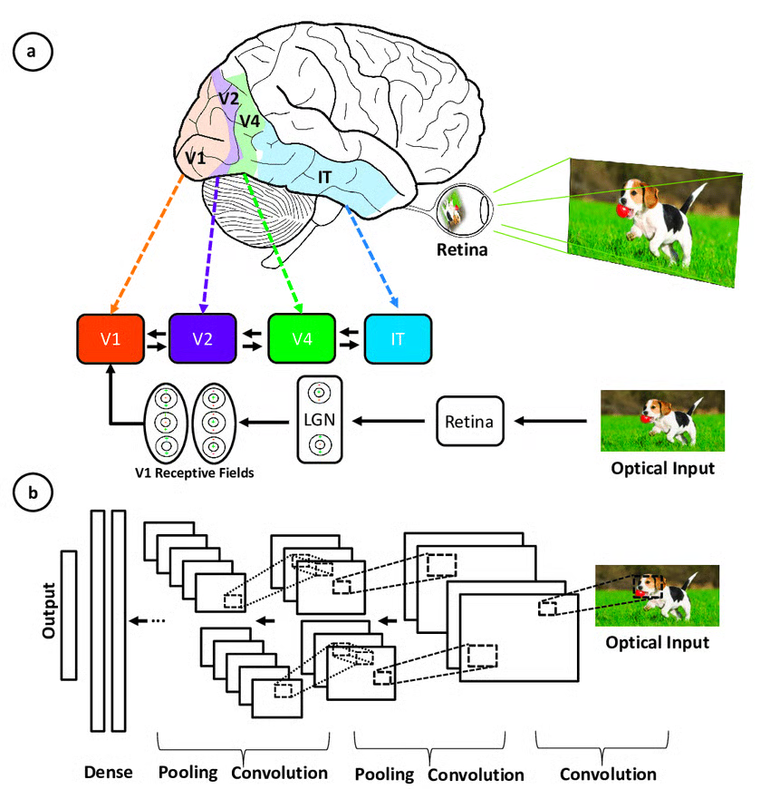
Convolutional neural networks were inspired by the layered architecture of the human visual cortex, and below are some key similarities and differences:

Slide 5
areas associated with the primary visual cortex and the layers in a convolutional neural network
Hierarchical architecture: Both CNNs and the visual cortex have a hierarchical structure, with simple features extracted in early layers and more complex features built up in deeper layers. This allows increasingly sophisticated representations of visual inputs.
Local connectivity: Neurons in the visual cortex only connect to a local region of the input, not the entire visual field. Similarly, the neurons in a CNN layer are only connected to a local region of the input volume through the convolution operation. This local connectivity enables efficiency.
Translation invariance: Visual cortex neurons can detect features regardless of their location in the visual field. Pooling layers in a CNN provide a degree of translation invariance by summarizing local features.
Multiple feature maps: At each stage of visual processing, there are many different feature maps extracted. CNNs mimic this through multiple filter maps in each convolution layer.
Non-linearity: Neurons in the visual cortex exhibit non-linear response properties. CNNs achieve non-linearity through activation functions like ReLU applied after each convolution.
CNNs mimic the human visual system but are simpler, lacking its complex feedback mechanisms and relying on supervised learning rather than unsupervised, driving advances in computer vision despite these differences.

Slide 6
What is a Convolutional Neural Network?
In machine learning, a classifier assigns a class label to a data point. For example, an image classifier produces a class label (e.g, bird, plane) for what objects exist within an image. A convolutional neural network, or CNN for short, is a type of classifier, which excels at solving this problem!
A CNN is a neural network: an algorithm used to recognize patterns in data. Neural Networks in general are composed of a collection of neurons that are organized in layers, each with their own learnable weights and biases. Let’s break down a CNN into its basic building blocks.
A tensor can be thought of as an n-dimensional matrix. In the CNN above, tensors will be 3-dimensional with the exception of the output layer.
A neuron can be thought of as a function that takes in multiple inputs and yields a single output. The outputs of neurons are represented above as the red → blue activation maps.
A layer is simply a collection of neurons with the same operation, including the same hyperparameters.
Kernel weights and biases, while unique to each neuron, are tuned during the training phase, and allow the classifier to adapt to the problem and dataset provided. They are encoded in the visualization with a yellow → green diverging colorscale. The specific values can be viewed in the Interactive Formula View by clicking a neuron or by hovering over the kernel/bias in the Convolutional Elastic Explanation View.
A CNN conveys a differentiable score function, which is represented as class scores in the visualization on the output layer.
If you have studied neural networks before, these terms may sound familiar to you. So what makes a CNN different? CNNs utilize a special type of layer, aptly named a convolutional layer, that makes them well-positioned to learn from image and image-like data. Regarding image data, CNNs can be used for many different computer vision tasks, such as image processing, classification, segmentation, and object detection.

Slide 7

https://poloclub.github.io/cnn-explainer/

Slide 8
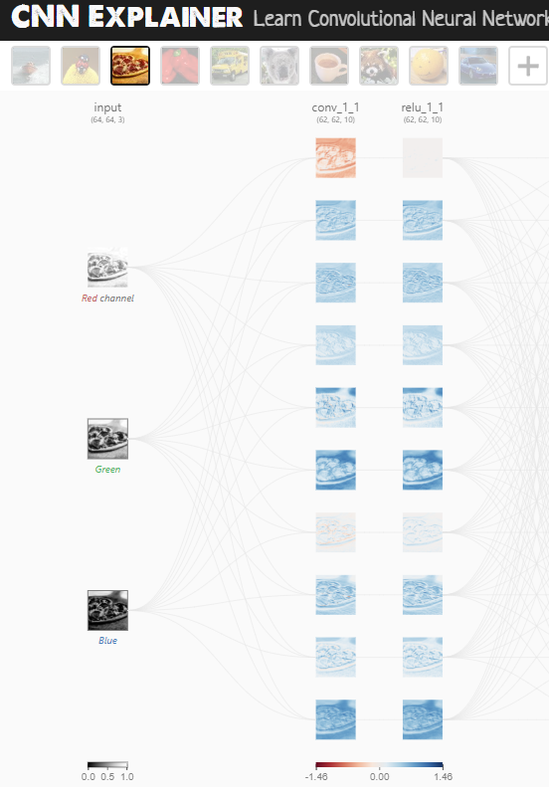
What does each layer of the network do?
Input Layer
The input layer (leftmost layer) represents the input image into the CNN. Because we use RGB images as input, the input layer has three channels, corresponding to the red, green, and blue channels, respectively, which are shown in this layer.
Use the color scale when you click on the network details icon icon above to display detailed information (on this layer, and others).

Slide 9
Convolutional Layers
The convolutional layers are the foundation of CNN, as they contain the learned kernels (weights), which extract features that distinguish different images from one another—this is what we want for classification!
As you interact with the convolutional layer, you will notice links between the previous layers and the convolutional layers.
Each link represents a unique kernel, which is used for the convolution operation to produce the current convolutional neuron’s output or activation map.
The convolutional neuron performs an elementwise dot product with a unique kernel and the output of the previous layer’s corresponding neuron. This will yield as many intermediate results as there are unique kernels. The convolutional neuron is the result of all of the intermediate results summed together with the learned bias.
For example, let’s look at the first convolutional layer in the Tiny VGG architecture above. Notice that there are 10 neurons in this layer, but only 3 neurons in the previous layer. In the Tiny VGG architecture, convolutional layers are fully-connected, meaning each neuron is connected to every other neuron in the previous layer. Focusing on the output of the topmost convolutional neuron from the first convolutional layer, we see that there are 3 unique kernels when we hover over the activation map.

Slide 10
Convolutional Neural Networks
Convolutional Neural Networks (CNNs) have an input layer, an output layer, numerous hidden layers, and millions of parameters, allowing them to learn complicated objects and patterns.
It uses convolution and pooling processes to sub-sample the given input before applying an activation function, where all of them are hidden layers that are partially connected, with the completely connected layer at the end resulting in the output layer.
The output shape is similar to the size of the input image.

Slide 11
Process
Convolution is the process of combining two functions to produce the output of the other function.
The input image is convoluted with the application of filters in CNNs, resulting in a Feature map.
Filters are weights and biases that are randomly generated vectors in the network.
Instead of having individual weights and biases for each neuron, CNN uses the same weights and biases for all neurons.
Many filters can be created, each of which catches a different aspect from the input. Kernels are another name for filters.

Slide 12
Convolutional Layer
In convolutional neural networks, the major building elements are convolutional layers. This layer often contains input vectors, such as an image, filters, such as a feature detector, and output vectors, such as a feature map.
The image is abstracted to a feature map, also known as an activation map, after passing through a convolutional layer.

Slide 13
Feature Map = Input Image x Feature Detector
The input is convolved by convolutional layers, which then pass the output to the next layer.
This is analogous to a neuron’s response to a single stimulus in the visual cortex. Each convolutional neuron only processes data for the receptive field it is assigned to.
A convolution is a grouping function in mathematics.
Convolution occurs in CNNs when two matrices (rectangular arrays of numbers arranged in columns and rows) are combined to generate a third matrix.
In the convolutional layers of a CNN, these convolutions are used to filter input data and find information.

Slide 14
Three Feature maps
Those three feature maps are now added up element-wise, resulting in one single feature map for the first filter.
Because we have initalised a second filter, the same process is repeated, but this time with different weights.
This combination enhances the network’s ability to recognize complex patterns that may involve interactions between different color channels.
Each feature map highlights patterns, edges, or textures. The weights of each filter are learned through backpropagation.

Slide 15
The size of these kernels is a hyper-parameter specified by the designers of the network architecture.
In order to produce the output of the convolutional neuron (activation map), we must perform an elementwise dot product with the output of the previous layer and the unique kernel learned by the network.
In TinyVGG, the dot product operation uses a stride of 1, which means that the kernel is shifted over 1 pixel per dot product, but this is a hyperparameter that the network architecture designer can adjust to better fit their dataset.
We must do this for all 3 kernels, which will yield 3 intermediate results.

Slide 16
Understanding Hyperparameters
https://poloclub.github.io/cnn-explainer/

Slide 17
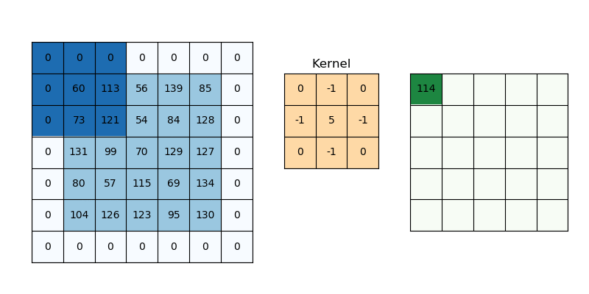
Padding and Stride
Padding and stride have an impact on how the convolution procedure is carried out. They can be used to increase or decrease the dimensions (height and width) of input/output vectors.
It is a term used in convolutional neural networks to describe how many pixels are added to an image when it is processed by the CNN kernel. If the padding in a CNN is set to zero, for example, every pixel value-added will have the value zero. If the zero padding is set to one, a one-pixel border with a pixel value of zero will be added to the image.
https://stanford.edu/~shervine/teaching/cs-230/cheatsheet-convolutional-neural-networks

Slide 18
Padding
Padding works by increasing the processing region of a convolutional neural network.
The kernel is a neural network filter that moves through a picture, scanning each pixel and turning the data into a smaller or bigger format.
Padding is added to the image frame to aid the kernel in processing the image by providing more room for the kernel to cover the image. Adding padding to a CNN-processed image provides for more accurate image analysis.
Padding is often necessary when the kernel extends beyond the activation map.
Padding conserves data at the borders of activation maps, which leads to better performance, and it can help preserve the input's spatial size, which allows an architecture designer to build deeper, higher performing networks.
There exist many padding techniques, but the most commonly used approach is zero-padding because of its performance, simplicity, and computational efficiency.
The technique involves adding zeros symmetrically around the edges of an input.
This approach is adopted by many high-performing CNNs such as AlexNet.

Slide 19
Kernel size
Kernel size, often also referred to as filter size, refers to the dimensions of the sliding window over the input.
Choosing this hyperparameter has a massive impact on the image classification task. For example, small kernel sizes are able to extract a much larger amount of information containing highly local features from the input.
As you can see on the visualization above, a smaller kernel size also leads to a smaller reduction in layer dimensions, which allows for a deeper architecture. Conversely, a large kernel size extracts less information, which leads to a faster reduction in layer dimensions, often leading to worse performance. Large kernels are better suited to extract features that are larger.
At the end of the day, choosing an appropriate kernel size will be dependent on your task and dataset, but generally, smaller kernel sizes lead to better performance for the image classification task because an architecture designer is able to stack more and more layers together to learn more and more complex features!
https://medium.com/@abhishekjainindore24/all-about-convolutions-kernels-features-in-cnn-c656616390a1

Slide 20
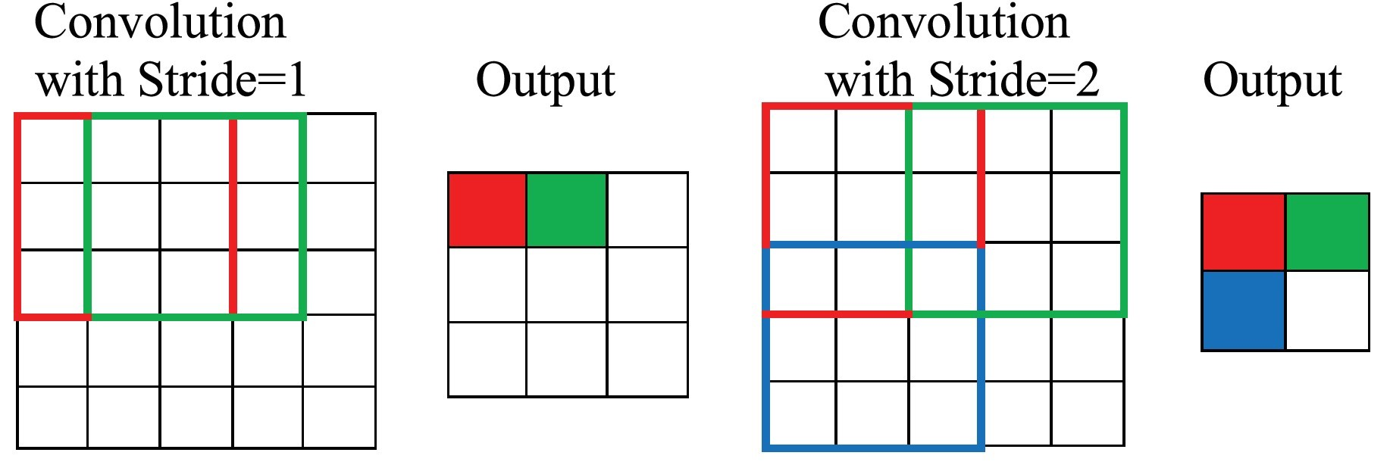
Stride
Stride determines how the filter convolves over the input matrix, i.e. how many pixels shift. When stride is set to 1, the filter moves across one pixel at a time, and when the stride is set to 2, the filter moves across two pixels at a time. The smaller the stride value, the smaller the output, and vice versa.

Slide 21
Stride
Stride indicates how many pixels the kernel should be shifted over at a time.
For example, as described in the convolutional layer example above, Tiny VGG uses a stride of 1 for its convolutional layers, which means that the dot product is performed on a 3x3 window of the input to yield an output value, then is shifted to the right by one pixel for every subsequent operation.
The impact stride has on a CNN is similar to kernel size.
As stride is decreased, more features are learned because more data is extracted, which also leads to larger output layers.
On the contrary, as stride is increased, this leads to more limited feature extraction and smaller output layer dimensions.
One responsibility of the architecture designer is to ensure that the kernel slides across the input symmetrically when implementing a CNN.
Use the hyperparameter visualization above to alter stride on various input/kernel dimensions to understand this constraint!

Slide 22
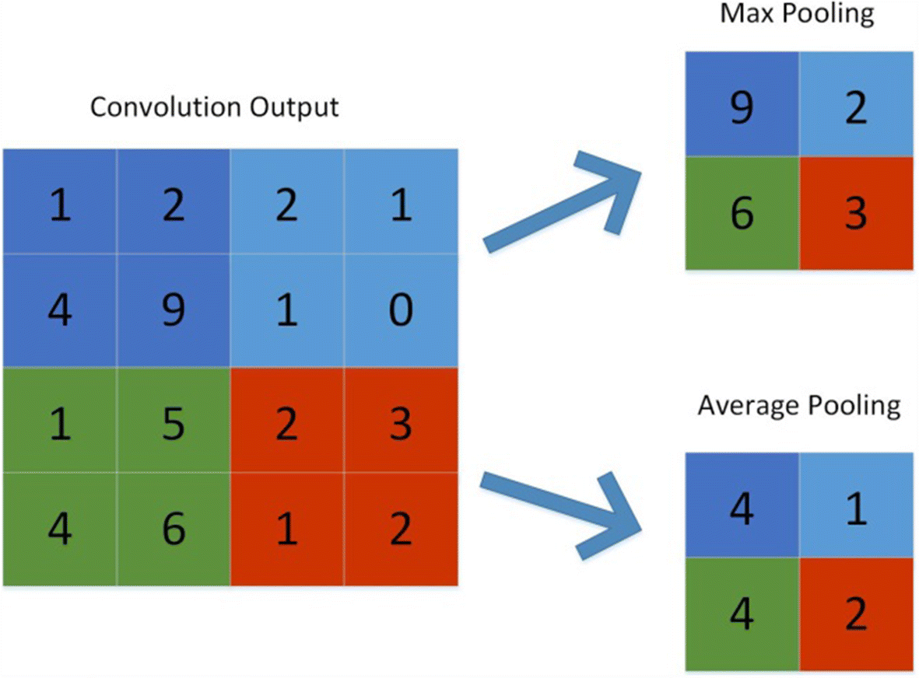
Pooling
Its purpose is to gradually shrink the representation’s spatial size to reduce the number of parameters and computations in the network. The pooling layer treats each feature map separately.

Slide 23
Methods for pooling:
Max-pooling: It chooses the most significant element from the feature map. The feature map’s significant features are stored in the resulting max-pooled layer. It is the most popular method since it produces the best outcomes.
Average pooling: It entails calculating the average for each region of the feature map.
Pooling gradually reduces the spatial dimension of the representation to reduce the number of parameters and computations in the network, as well as to prevent overfitting. If there is no pooling, the output has the same resolution as the input.

Slide 24
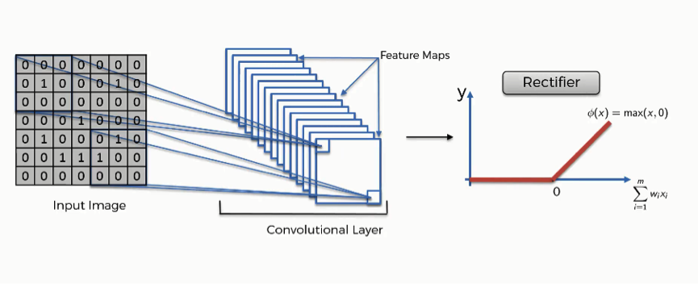
ReLU
The rectified linear activation function, or ReLU for short, is a piecewise linear function that, if the input is positive, outputs the input directly; else, it outputs zero. Because a model that utilizes it is quicker to train and generally produces higher performance, it has become the default activation function for many types of neural networks.

Slide 25
CNN
At the end of CNN, there is a Fully connected layer of neurons. As in conventional Neural Networks, neurons in a fully connected layer have full connections to all activations in the previous layer and work similarly.
After training, the feature vector from the fully connected layer is used to classify images into distinct categories.
Every activation unit in the next layer is coupled to all of the inputs from this layer.
Overfitting occurs because all of the parameters are occupied in the fully-connected layer.
Overfitting can be reduced using a variety of strategies, including dropout.

Slide 26
Soft-max
is an activation layer that is typically applied to the network’s last layer, which serves as a classifier. This layer is responsible for categorizing provided input into distinct types. A network’s non-normalized output is mapped to a probability distribution using the softmax function.

Slide 27
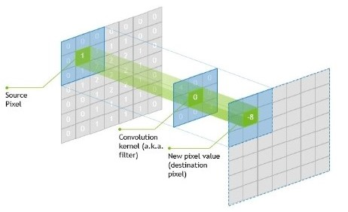
The kernel’s centre element is put above the source pixel.
After that, the source pixel is replaced with a weighted sum of itself and neighboring pixels.
Parameter sharing and local connectivity are two principles used in CNNs.
All neurons in a feature map share weights, which is known as parameter sharing.
Local connection refers to the idea of each neural being connected to only a part of
the input image (as opposed to a neural network in which all neurons are fully connected).
This reduces the number of parameters in the system and speeds up the calculation.

Slide 28
Filters/Kernels
A filter, or kernel, in a CNN is a small matrix of weights that slides over the input data (such as an image), performs element-wise multiplication with the part of the input it is currently on, and then sums up all the results into a single output pixel.
This process is known as convolution.

Slide 29
Filter works
Filters are at the heart of what makes CNNs work. They are the primary component that helps the model extract useful features from the input data.
Size: Filters are typically small, square matrices. A filter’s size is a crucial hyperparameter that you must set. Common dimensions include 3x3, 5x5, and 7x7.
Sliding the Filter: The filter slides across the input data, moving by a certain number of pixels each time, defined by the “stride” (which we’ll discuss later). At each position, the filter covers a small portion of the input image.
Convolution Operation: At each position, the filter performs an operation on the part of the image it’s currently on. This operation involves element-wise multiplication of the filter’s weights and the pixel values in the image, followed by summing these results. This produces a single value that represents that specific location on the output feature map.
Learning: During training, the CNN learns the best values for the filter weights to achieve the task at hand (e.g., classifying images, detecting objects, etc.). This is done through backpropagation and optimization algorithms, just like any other weights in a neural network.
Feature Extraction: Filters are responsible for feature extraction in CNNs. For example, some filters might become specialized to detect horizontal edges in an image, others might detect vertical edges, colors, textures, etc. As the model becomes deeper, the filters can recognize more complex patterns.

Slide 30
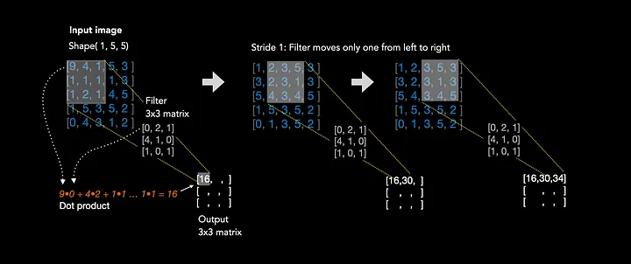
Convolution process
For example, in image processing, filters might be designed to detect edges, corners, or textures. In deep learning, the weights of these filters are learned automatically through training on large datasets.

Slide 31
explanation of image convolution operation
Figure 1 illustrates the convolutional operation. We have one input matrix of shape (1,5,5), which could be a very small black and white image for example.
The pixel values of an image are the features, because each pixel value represents the intensity of light at a given location.
We want to learn the relationship between those features in an image in order to detect objects, faces etc.
In order to do that, we apply kernels, which are small weight matrices, in this case of size (3,3) to the input.
We start in the top left corner and perform the dot product between the overlapping input section and the kernel.
In this case: 9•0 + 4•2 + 1•1 + 1•4 + 1•1 + 1•0 + 1•1 + 2•0 + 1•1 = 16.
Now, we are done with the first 3x3 pixel values and we move the kernel one to the right and start again, resulting in a value of 30.
We repeat the whole operation until the kernel covered every pixel of the input image.

Slide 32
Feature map
The output matrix is called feature map.
Feature maps are not directly interpretable by humans, but they serve as a way for the network to capture and encode the presence of specific features in the input data.
As the network learns from data during training, it adapts its filters to recognize features that are relevant to the task at hand, such as classifying objects in images.

Slide 33
Convolutional operation on coloured RGB images
An coloured Image in RGB format has the shape (width, height, colour channels), which is sometimes represented in a different order: (colour channels, width, height).
Thus, the input image now comes with three colour matrices.
The following section explains how the kernel operation is performed in the case of RGB images.

Slide 34
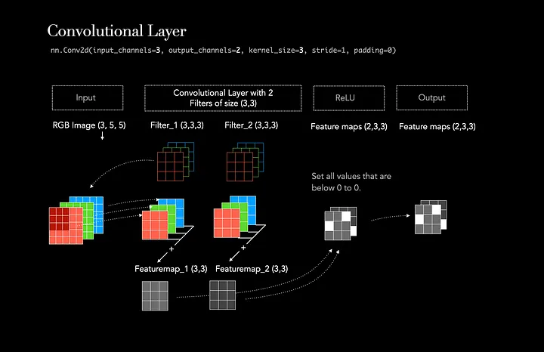
Example
Imagine we apply one convolutional layer with 2 filters of size (3,3) on a coloured input image with 5x5 pixels.

Slide 35
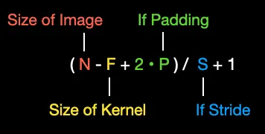
Input channel and weight matrices
The illustration above demonstrates the process of applying 2 filters/kernels to one image, resulting in 2 feature maps.
First, each filter is initialized with a random weight matrix for each input channel.
In our case, the input image has 3 input channels (Red, Green, Blue), thus each filter comes with three weight matrices.
During the operation, all three weight matrices, of each filter, are applied to all three corresponding color channels.
This results in three new matrices of size 3x3, called feature maps.
The new size of each feature map is calculated through:

Slide 36
Same Opertion in Pytorch:
nn.Conv2d(input_channels=3, output_channels=2, kernel_size=3, stride=1, padding=0)

Slide 37
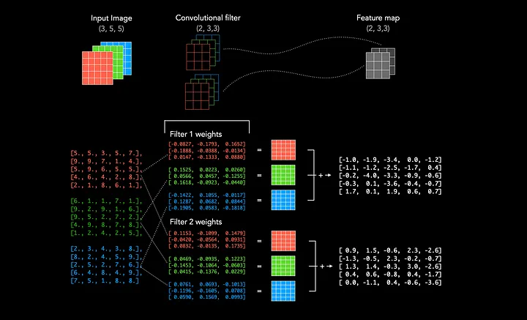

Slide 38
Understanding the Data Forward-Pass
Convolutional Layer (2 Kernels, Kernel-size of 3, ReLU activation)
Max Pooling Layer
Dropout Layer
—------------------------------------------
The illustration below demonstrates how the pixel values of a black and white input image of size (5,5) are transformed through these layers.
Initially, both weight matrices (depicted in blue) of the kernels are randomly initialized and applied to the input image.
This results in two feature maps, each of size (3,3).
The Max Pooling layer then reduces the size of the feature maps to a matrix of (2,2).
Finally, the Dropout layer randomly sets each value with a specified probability to zero.
In this case, the dropout rate is 50%. To proceed with a fully connected layer, we must flatten the matrices and concatenate them.

Slide 39
Flatten Layer
This layer converts a three-dimensional layer in the network into a one-dimensional vector to fit the input of a fully-connected layer for classification.
For example, a 5x5x2 tensor would be converted into a vector of size 50. The previous convolutional layers of the network extracted the features from the input image, but now it is time to classify the features.
We use the softmax function to classify these features, which requires a 1-dimensional input. This is why the flatten layer is necessary. This layer can be viewed by clicking any output class.

Slide 40
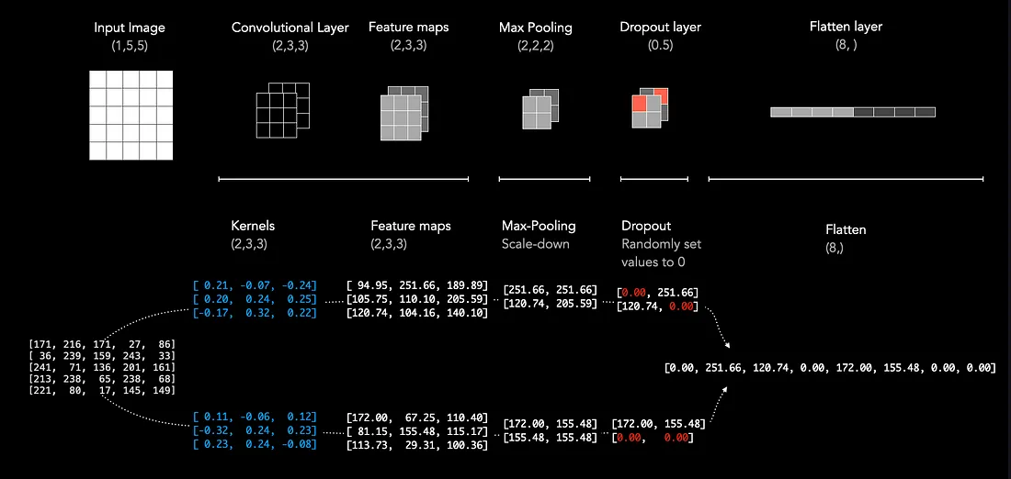

Slide 41
from tensorflow.keras.models import Sequential
from tensorflow.keras.layers import Conv2D, MaxPooling2D, Flatten, Dense
# Load and pre-process data
# ...
# Define the CNN model
model = Sequential()
# Convolutional layer with 32 filters and kernel size 3x3
model.add(Conv2D(32, (3, 3), activation="relu", input_shape=(image_height, image_width, channels)))

Slide 42
# Max pooling layer with pool size 2x2
model.add(MaxPooling2D(pool_size=(2, 2)))
# Add another convolutional layer with 64 filters and kernel size 3x3
model.add(Conv2D(64, (3, 3), activation="relu"))
# Max pooling again
model.add(MaxPooling2D(pool_size=(2, 2)))
# Flatten extracted features
model.add(Flatten())

Slide 43
# Dense layer with 128 neurons
model.add(Dense(128, activation="relu"))
# Output layer with 10 neurons for 10 classes
model.add(Dense(10, activation="softmax"))
# Compile the model
model.compile(loss="categorical_crossentropy", optimizer="adam", metrics=["accuracy"])
# Train the model
model.fit(train_images, train_labels, epochs=10, validation_data=(val_images, val_labels))

Slide 44
# Evaluate model performance on test data
loss, accuracy = model.evaluate(test_images, test_labels)
print("Test loss:", loss)
print("Test accuracy:", accuracy)

Slide 45
CNN example of ANN program
import tensorflow as tf
from tensorflow.keras.datasets import mnist
from tensorflow.keras.models import Sequential
from tensorflow.keras.layers import Conv2D, MaxPooling2D, Flatten, Dense
# Load MNIST dataset
(x_train, y_train), (x_test, y_test) = mnist.load_data()
# Preprocess data (normalize)
x_train = x_train.astype('float32') / 255.0
x_test = x_test.astype('float32') / 255.0

Slide 46
# Reshape to include channels (required for CNN)
x_train = x_train.reshape(x_train.shape[0], 28, 28, 1)
x_test = x_test.reshape(x_test.shape[0], 28, 28, 1)
# One-hot encode labels
y_train = tf.keras.utils.to_categorical(y_train, 10)
y_test = tf.keras.utils.to_categorical(y_test, 10)
# Define and train CNN model
model = Sequential([
Conv2D(32, kernel_size=(3, 3), activation='relu', input_shape=(28, 28, 1)), # Convolutional layer
MaxPooling2D((2, 2)), # Pooling layer to reduce dimensionality
Flatten(),
Dense(128, activation='relu'), # Hidden layer
Dense(10, activation='softmax') # Output layer
])

Slide 47
model.compile(optimizer='adam', loss='categorical_crossentropy', metrics=['accuracy'])
model.fit(x_train, y_train, epochs=10, batch_size=32, validation_data=(x_test, y_test))
# Evaluate model performance
test_loss, test_acc = model.evaluate(x_test, y_test)
print('Test accuracy:', test_acc)

Slide 48
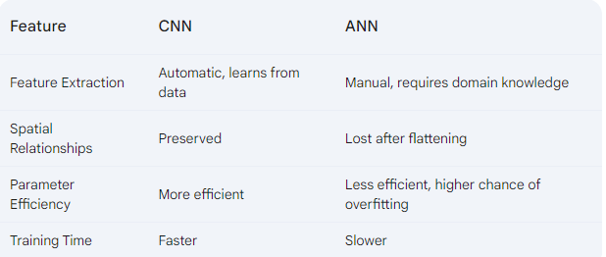

Slide 49
What are recurrent neural networks?
A recurrent neural network (RNN) is a type of artificial neural network which uses sequential data or time series data.
These deep learning algorithms are commonly used for ordinal or temporal problems, such as language translation, natural language processing (nlp), speech recognition, and image captioning; they are incorporated into popular applications such as Siri, voice search, and Google Translate.
Like feedforward and convolutional neural networks (CNNs), recurrent neural networks utilize training data to learn.

Slide 50
RNN…
A single-time step of the input is provided to the network.
Then calculate its current state using a set of current input and the previous state.
The current ht becomes ht-1 for the next time step.
One can go as many time steps according to the problem and join the information from all the previous states.
Once all the time steps are completed the final current state is used to calculate the output.
The output is then compared to the actual output i.e the target output and the error is generated.
The error is then back-propagated to the network to update the weights and hence the network (RNN) is trained using Backpropagation through time.
https://medium.com/analytics-vidhya/backpropagation-for-dummies-e069410fa585

Slide 51
More about RNN.
They are distinguished by their “memory” as they take information from prior inputs to influence the current input and output.
While traditional deep neural networks assume that inputs and outputs are independent of each other, the output of recurrent neural networks depend on the prior elements within the sequence.
While future events would also be helpful in determining the output of a given sequence, unidirectional recurrent neural networks cannot account for these events in their predictions.

Slide 52
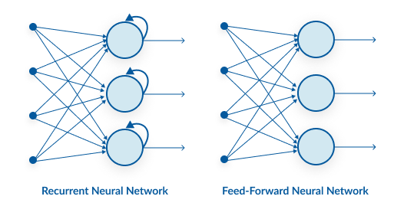
Feed-forward neural networks are poor predictions of what will happen next because they have no memory of the
information they receive. Because it simply analyses the current input, a feed-forward network has no idea of temporal
order. Apart from its training, it has no memory of what transpired in the past.
The information is in an RNN cycle via a loop. Before making a judgment, it evaluates the current input as well as what
it has learned from past inputs. A recurrent neural network, on the other hand, may recall due to internal memory.
It produces output, copies it, and then returns it to the network.

Slide 53
How does Recurrent Neural Networks work?

Slide 54
Gif file ….
The input layer x receives and processes the neural network’s input before passing it on to the middle layer.
Multiple hidden layers can be found in the middle layer h, each with its own activation functions, weights, and biases. You can utilize a recurrent neural network if the various parameters of different hidden layers are not impacted by the preceding layer, i.e. There is no memory in the neural network.
The different activation functions, weights, and biases will be standardized by the Recurrent Neural Network, ensuring that each hidden layer has the same characteristics. Rather than constructing numerous hidden layers, it will create only one and loop over it as many times as necessary.

Slide 55
Another distinguishing characteristic of recurrent networks is that they share parameters across each layer of the network.
While feedforward networks have different weights across each node, recurrent neural networks share the same weight parameter within each layer of the network.
That said, these weights are still adjusted in the through the processes of backpropagation and gradient descent to facilitate reinforcement learning.

Slide 56
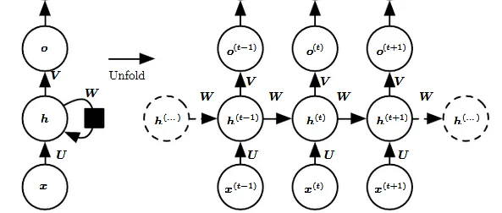

Slide 57
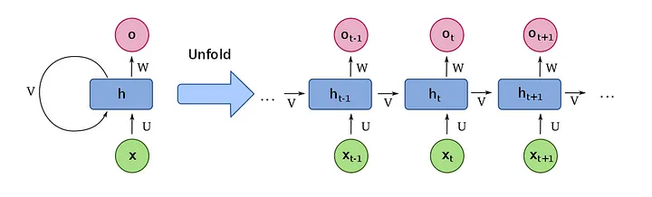
why RNN?
This means that the output of the previous layer is fed into the next layer for making predictions, repeating the same structure, hence the name ‘Recurrent’ Neural Network.

Slide 58
https://distill.pub/2019/memorization-in-rnns/
https://wandb.ai/authors/rnn-viz/reports/Under-the-Hood-of-Recurrent-Neural-Networks--VmlldzoyNTQ4MjY

Slide 59
The left side of the above diagram shows a notation of an RNN and on the right side an RNN being unrolled (or unfolded) into a full network. By unrolling we mean that we write out the network for the complete sequence.
For example, if the sequence we care about is a sentence of 3 words, the network would be unrolled into a 3-layer neural network, one layer for each word.

Slide 60
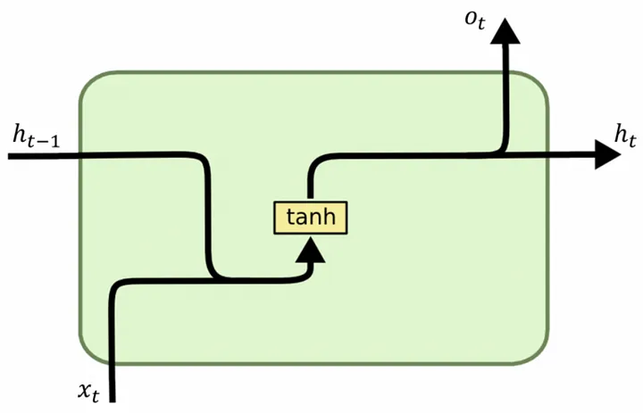
Simple RNN Block
X: Input. Eg, a word or any other type of sequential data
O: Output. The next word or sequence is an output from the network.
h(t): Represents a hidden state at time t and acts as the “memory” of the network.
V: Represents the communication from one time-step to the other.

Slide 61
Understanding of RNN Block
Input: x(t)​ is taken as the input to the network at time step t. For example, x1,could be a one-hot vector corresponding to a word of a sentence.
Hidden state: h(t)​ represents a hidden state at time t and acts as “memory” of the network. h(t)​ is calculated based on the current input and the previous time step’s hidden state:
h(t)​ = f(U x(t)​ + W h(t−1)​). The function f is taken to be a non-linear transformation such as tanh, ReLU.
Weights: The RNN has input to hidden connections parameterized by a weight matrix U, hidden-to-hidden recurrent connections parameterized by a weight matrix W, and hidden-to-output connections parameterized by a weight matrix V and all these weights (U,V,W) are shared across time.
Output: o(t)​ illustrates the output of the network. In the figure I just put an arrow after o(t) which is also often subjected to non-linearity, especially when the network contains further layers downstream.

Slide 62
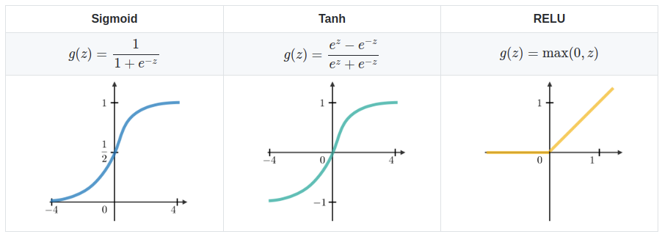
Common Activation Functions

Slide 63
Forward Pass
The ﬁgure does not specify the choice of activation function for the hidden units. Before we proceed we make few assumptions:
1) we assume the hyperbolic tangent activation function for hidden layer.
2) We assume that the output is discrete, as if the RNN is used to predict words or characters.
A natural way to represent discrete variables is to regard the output o as giving the un-normalized log probabilities of each possible value of the discrete variable.
We can then apply the softmax operation as a post-processing step to obtain a vector ŷ of normalized probabilities over the output.

Slide 64
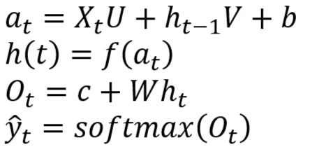
Forward Pass
The first equation defines the activation state at a given time step t, denoted by a t. It represents a linear combination of the current input x t ​ , the previous hidden state h t−1 and a bias vector b. We can rewrite this equation in a more compact form as at​=[xt​ ht−1​]T[U V]+b, where [U V] is a concatenation of the weight matrices U and V.
The second equation defines the hidden state at the current time step t, denoted by ht . It is obtained by applying an activation function f to the activation state at . Common activation functions used in RNNs include the sigmoid function and the hyperbolic tangent function.
The third equation defines the output of the RNN at the current time step t, denoted by ot​. It's a linear combination of the current hidden state ht​ and another weight matrix W combined with a bias vector.
The final equation shows the output of the softmax function, denoted by yt​^​, which takes the output ot​ as input. The softmax function squishes the elements of the output vector ot​ between 0 and 1 and makes them sum up to 1, effectively converting it into a probability distribution. This is particularly useful for classification problems.

Slide 65
Activation Function
where f is an activation function. Eg -> f = tanh -> h(t)=tanh(aₜ)
h(t)​ is calculated based on the current input and the previous time step’s hidden state h(t-1).
The function f is taken to be a non-linear transformation such as tanh, ReLU.
U is the input weight vector corresponding to the input X and
V is the weight vector corresponding to the memory.

Slide 66
Vanishing Gradient issue
In backpropagation, we calculate the gradient and then pass it to the network.
But the gradient of the time step t depends on all of the timesteps after that i.e. t+1, t+2, …
So, when the sequence length is large, then the gradient starts to vanish.
This causes the problem of vanishing gradient and the RNN can’t remember the long sequences.

Slide 67
What Is The Vanishing Gradient Problem?
The vanishing gradient problem was discovered by Sepp Hochreiter, a German computer scientist who has had an influential role in the development of recurrent neural networks in deep learning.
Now let’s explore the vanishing gradient problem in detail. As its name implies, the vanishing gradient problem is related to deep learning gradient descent algorithms. Recall that a gradient descent algorithm looks something like this:

Slide 68
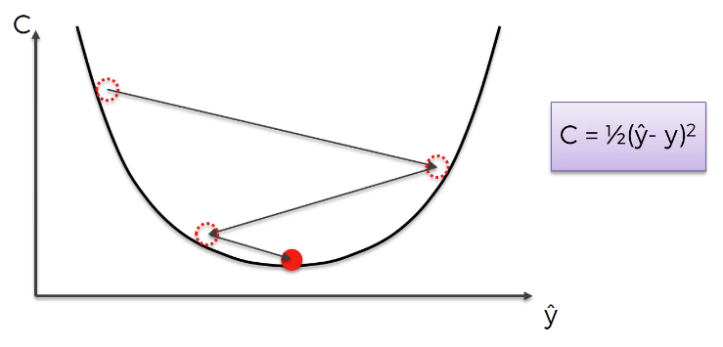

Slide 69
Backward Pass
The gradient computation involves performing a forward propagation pass moving left to right through the graph shown above followed by a backward propagation pass moving right to left through the graph.
The runtime is O(τ) and cannot be reduced by parallelization because the forward propagation graph is inherently sequential; each time step may be computed only after the previous one.
States computed in the forward pass must be stored until they are reused during the backward pass, so the memory cost is also O(τ).
The back-propagation algorithm applied to the unrolled graph with O(τ) cost is called back-propagation through time (BPTT).
Because the parameters are shared by all time steps in the network, the gradient at each output depends not only on the calculations of the current time step, but also the previous time steps.

Slide 70
Types of RNN
One To One: There is only one pair here. A one-to-one architecture is used in traditional neural networks.
One To Many: A single input in a one-to-many network might result in numerous outputs. One too many networks are used in the production of music, for example.
Many To One: In this scenario, a single output is produced by combining many inputs from distinct time steps. Sentiment analysis and emotion identification use such networks, in which the class label is determined by a sequence of words.
Many To Many: For many to many, there are numerous options. Two inputs yield three outputs. Machine translation systems, such as English to French or vice versa translation systems, use many to many networks.

Slide 71
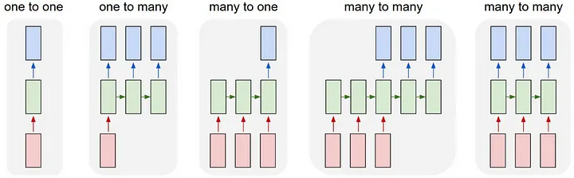
Notes:
https://medium.com/@archit.saxena/recurrent-neural-network-rnn-92faf7c01fd4

Slide 72
Key Differences Between CNN and RNN
CNN is applicable for sparse data like images. RNN is applicable for time series and sequential data.
While training the model, CNN uses a simple backpropagation and RNN uses backpropagation through time to calculate the loss.
RNN can have no restriction in length of inputs and outputs, but CNN has finite inputs and finite outputs.
CNN has a feedforward network and RNN works on loops to handle sequential data.
CNN can also be used for video and image processing. RNN is primarily used for speech and text analysis.

Slide 73
Limitations of RNN
Simple RNN models usually run into two major issues. These issues are related to gradient, which is the slope of the loss function along with the error function.
Vanishing Gradient problem occurs when the gradient becomes so small that updating parameters becomes insignificant; eventually the algorithm stops learning.
Exploding Gradient problem occurs when the gradient becomes too large, which makes the model unstable. In this case, larger error gradients accumulate, and the model weights become too large. This issue can cause longer training times and poor model performance.

Slide 74
RNN Advanced Architectures
The simple RNN repeating modules have a basic structure with a single tanh layer. RNN simple structure suffers from short memory, where it struggles to retain previous time step information in larger sequential data.
These problems can easily be solved by long short term memory (LSTM) and gated recurrent unit (GRU), as they are capable of remembering long periods of information.

Slide 75
Long Short Term Memory (LSTM)
The Long Short Term Memory (LSTM) is the advanced type of RNN, which was designed to prevent both decaying and exploding gradient problems.
Just like RNN, LSTM has repeating modules, but the structure is different.
Instead of having a single layer of tanh, LSTM has four interacting layers that communicate with each other.
This four-layered structure helps LSTM retain long-term memory and can be used in several sequential problems including machine translation, speech synthesis, speech recognition, and handwriting recognition

Slide 76
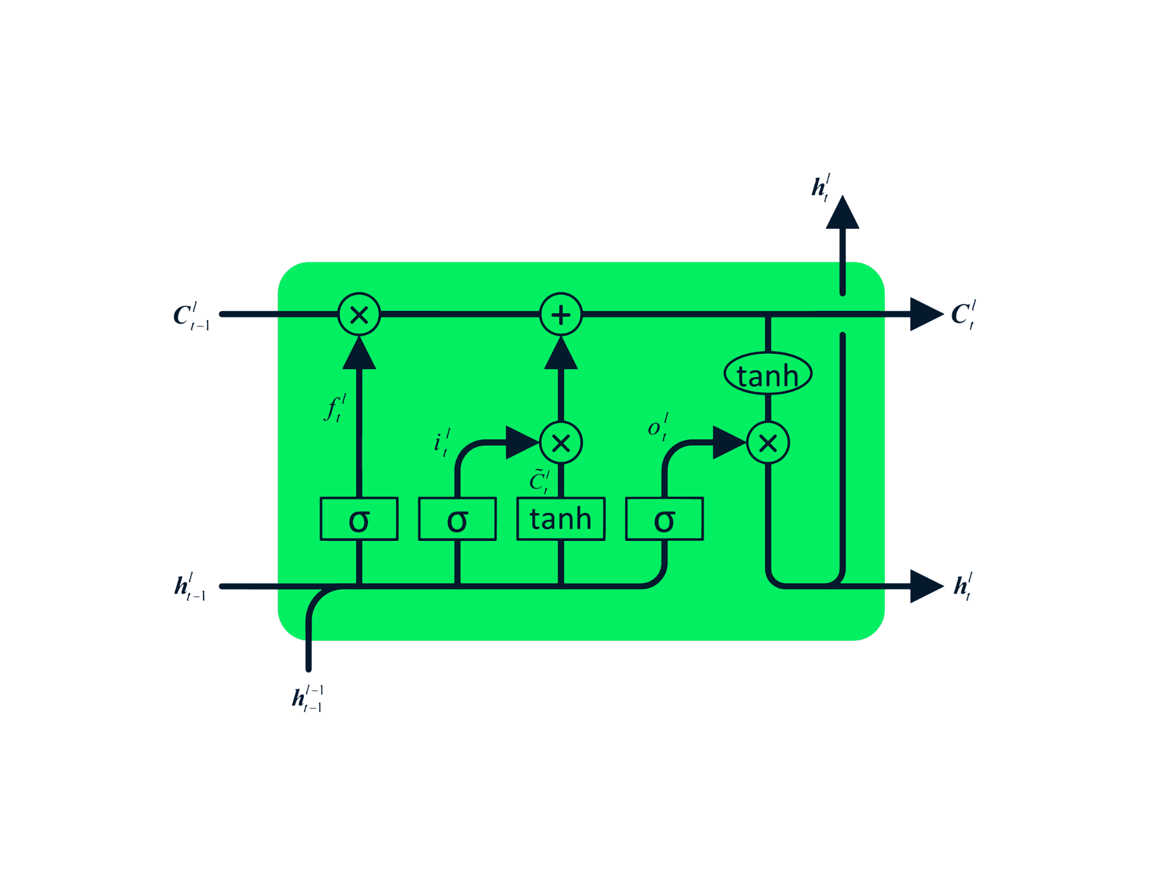

Slide 77
Gated Recurrent Unit (GRU)
The gated recurrent unit (GRU) is a variation of LSTM as both have design similarities, and in some cases, they produce similar results. GRU uses an update gate and reset gate to solve the vanishing gradient problem.
These gates decide what information is important and pass it to the output. The gates can be trained to store information from long ago, without vanishing over time or removing irrelevant information.
Unlike LSTM, GRU does not have cell state Ct.
It only has a hidden state ht, and due to the simple architecture, GRU has a lower training time compared to LSTM models.
The GRU architecture is easy to understand as it takes input xt and the hidden state from the previous timestamp ht-1 and outputs the new hidden state ht.

Slide 78
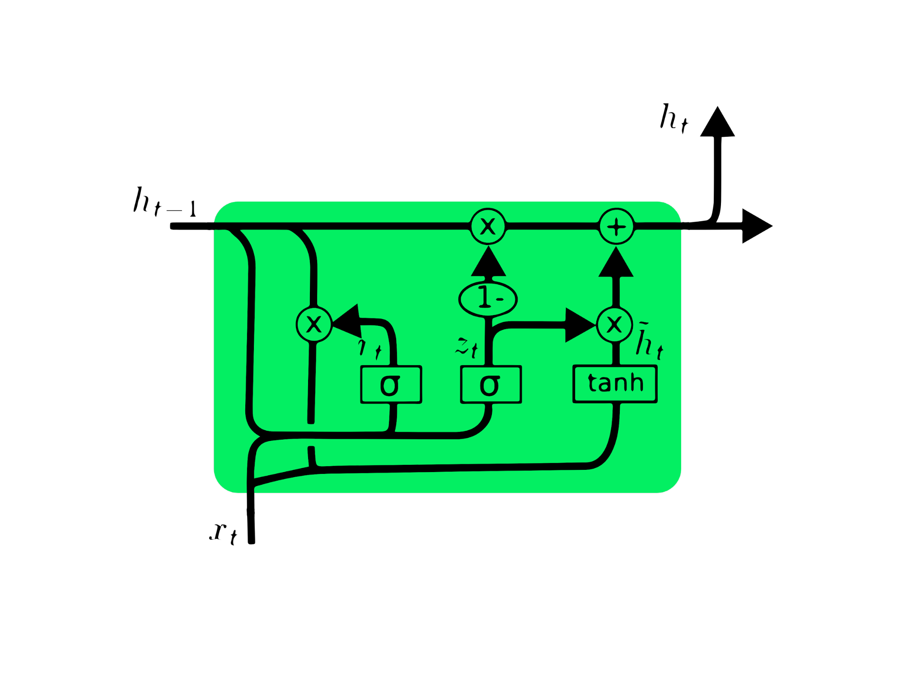

Slide 79
Implementation
General steps to follow:
Initialize weight matrices U, V, W from random distribution and bias b, c with zeros
Forward propagation to compute predictions
Compute the loss
Back-propagation to compute gradients
Update weights based on gradients
Repeat steps 2–5

Slide 80
Advantages and disadvantages of RNN
Advantages of RNNs:
Handle sequential data effectively, including text, speech, and time series.
Process inputs of any length, unlike feedforward neural networks.
Share weights across time steps, enhancing training efficiency.
Disadvantages of RNNs:
Prone to vanishing and exploding gradient problems, hindering learning.
Training can be challenging, especially for long sequences.
Computationally slower than other neural network architectures.
Recurrent Neural Network Vs Feedforwar

Slide 81
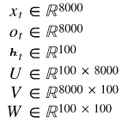
Step 1: Initialize
To start with the implementation of the basic RNN cell, we first define the dimensions of the various parameters U,V,W,b,c.
Dimensions:Let’s assume we pick a vocabulary size vocab_size= 8000 and a hidden layer size hidden_size=100. Then we have:
Vocabulary size can be the number of unique chars
for a char based model or number of unique words
for a word based model.

Slide 82
References
https://statso.io/next-word-prediction-case-study/
https://www.datacamp.com/tutorial/tutorial-for-recurrent-neural-network
https://www.geeksforgeeks.org/next-word-prediction-with-deep-learning-in-nlp/
https://www.superdatascience.com/blogs/the-ultimate-guide-to-convolutional-neural-networks-cnn
https://medium.com/@adachoudhry26/getting-started-with-ai-building-an-rnn-from-scratch-and-practicing-resilience-ba3c10be6a22
https://medium.com/@reddyyashu20/rnn-python-code-in-keras-and-pytorch-6ab842a85e15
https://www.analyticsvidhya.com/blog/2019/01/fundamentals-deep-learning-recurrent-neural-networks-scratch-python/
https://www.freecodecamp.org/news/the-ultimate-guide-to-recurrent-neural-networks-in-python/
https://www.datacamp.com/tutorial/tutorial-for-recurrent-neural-network
https://keras.io/examples/vision/video_classification/

